Slide 1
Today’s Agenda: Day 1
Election for Principal
  Each of you will come up one at a time to cast vote
Voting at the local, state, and national level
Woman Suffrage
  What’s this?
  What does this have to do with voting?
Wordle of what to expect
Notes:
Day 1

Slide 2
Principal Election Directions
When called on:
  Come to the front desk
  Bubble in a single vote for your candidate
  Fold vote in half twice
  Place in designated box
  Return to seat
While waiting to vote:
  Complete vocabulary handout for this Unit
Notes:
Leave up while students are voting. Sorry, fellas, but your votes do not count in this election. Get classroom back to order, Raise your hand: How did you feel when your votes did not count? How can you full participate in a classroom if you do not have a say by casting a vote? How does this impact your ability to full participate as a citizen of the USA if your vote does not count?

Slide 3


Voting: Every US Citizen’s Right (Today)
Local Level
State Level
National Level
In a democratic society, voting allows for citizens to voice on important policies and candidates to carry out the will of the people.
This was not always the case…

Slide 4
No Voting for Women
Less than 100 years ago, women were not allowed to vote at the national level.
Over 18 million women were cast aside as lesser citizens than the men.
To battle this injustice,
the Woman Suffrage Movement came to be during difficult times.

Slide 5
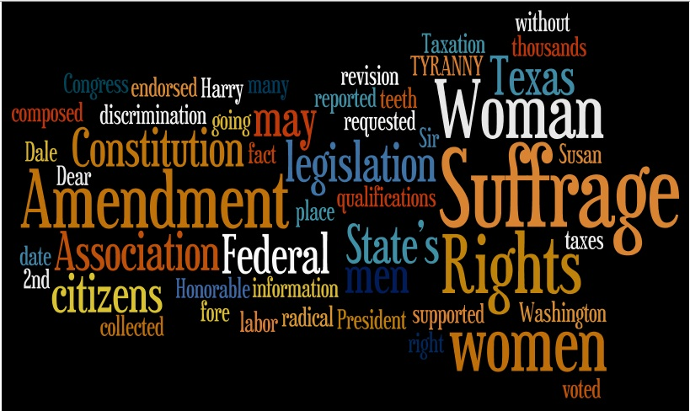
http://www.wordle.net/show/wrdl/3351566/TexasWomanSuffrageAssociationPetition

Slide 6
Today’s Agenda: Day 2
Wordle
Literary Digest Article
Map of Woman Suffrage
Woman Suffrage Class Debate

Slide 7

1908

Slide 8
